Slide 1
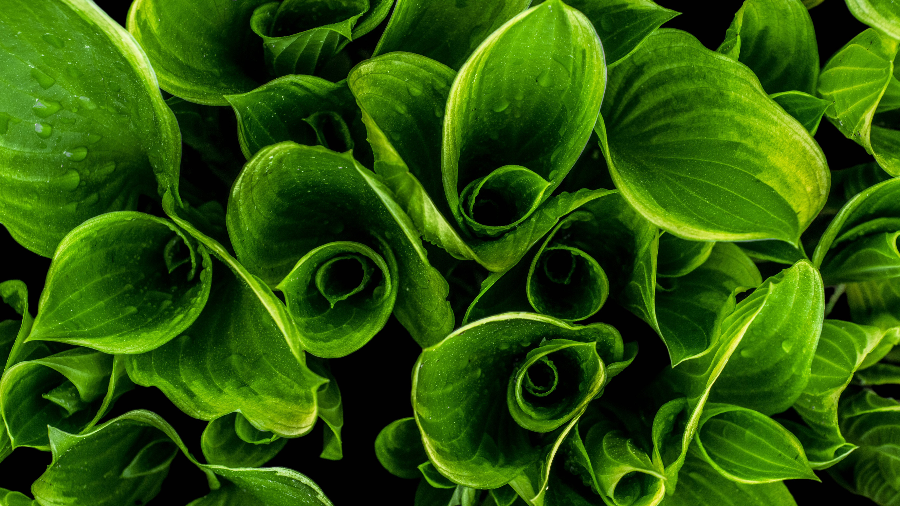
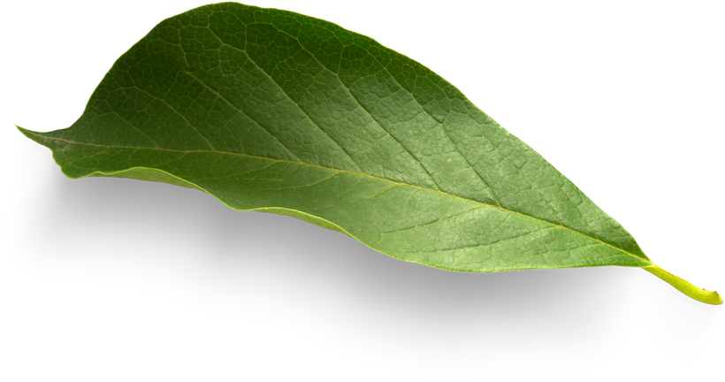

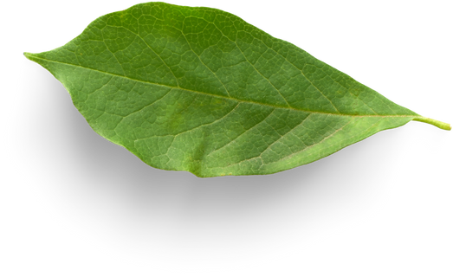
Green
Bangladesh

Slide 2
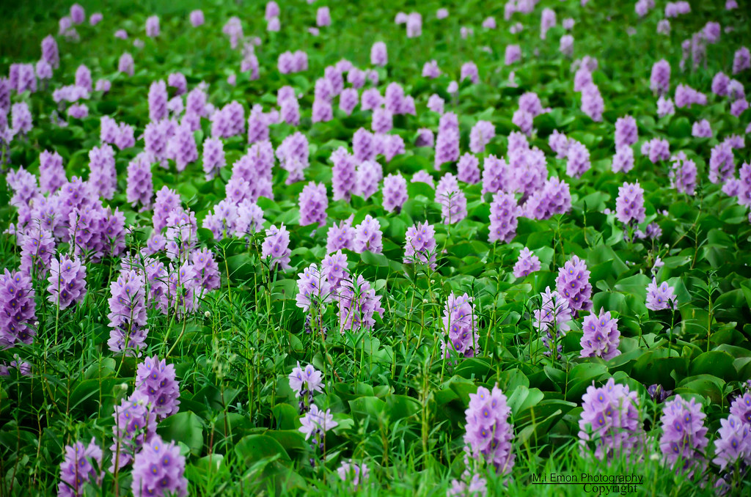

Home
Services
Features
About Us
Kocuri Pana – From Nature to Need
Nature is not a place we visit — it’s our origin, our responsibility, and the core of everything we create.
Presented by: Anidro Paul & MD Nure Alam

Slide 3


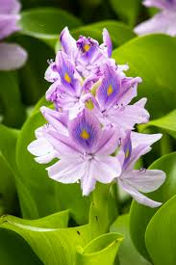

Salford & Co.
Home
Services
Features
About Us
introduction
What is Kocuri Pana?
Kocuri Pana (Water Hyacinth) is a common aquatic plant found in rural Bangladesh.
Water Hyacinth
It’s often treated as waste but holds hidden potential:
Strong natural fiber
A floral fragrance in its flowers
Biodegradable and abundant
We are upcycling this resource into:
Handmade crafts for Fiverr
Eco washroom fragrances from Kocuri flowers

Slide 4


Salford & Co.
Home
Services
Features
About Us
The Problem in
Bangladesh
1
2
3
4
Plastic waste rising due to synthetic consumer goods
Youth unemployment is a growing concern
Natural resources like Kocuri Pana remain underutilized
Most washroom fresheners use harmful chemicals

Slide 5

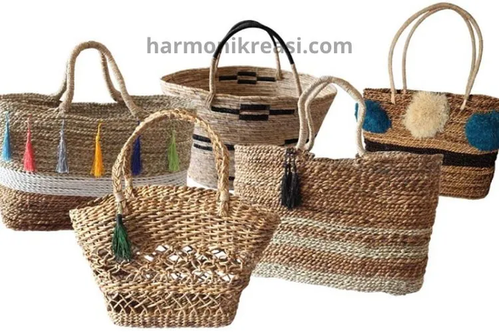
Salford & Co.
Home
Services
Features
About Us
Turn waste into wealth
Our Green
Extract natural fragrance from Kocuri flowers
Handcraft unique products from dried leaves
Engage rural women and youth for production & income
Solution
Kocuri Pana – The Power of Nature

Slide 6
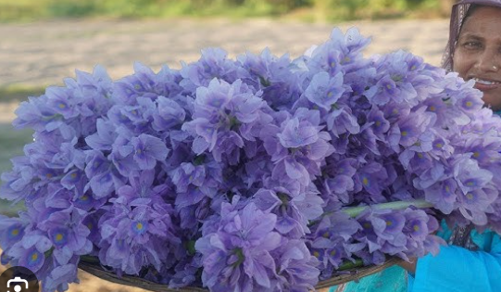
Home
Services
Features
About Us
Our Products
Washroom Fragrance:
Fiverr Crafts:
Wall decor, bookmarks, eco-cards
Made with dried Kocuri Pana leaves
Sold to eco-conscious buyers worldwide
Floral air freshener from Kocuri flowers
Chemical-free, eco-safe
Ideal for homes, resorts, offices in Bangladesh

Slide 7
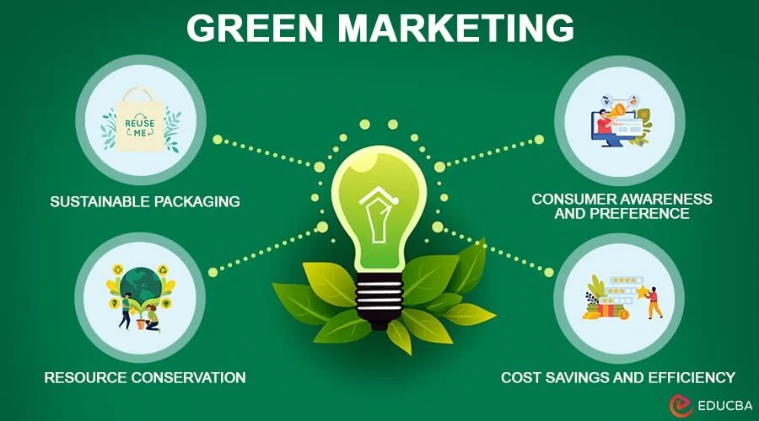
Home
Services
Features
About Us
Target Market
Fragrance (Bangladesh):
Crafts (Fiverr):
Global eco-lifestyle buyers
Handmade product collectors
Green-conscious gift seekers
Urban households
Eco-friendly offices & hotels
Organic product buyers & gift pack brands

Slide 8
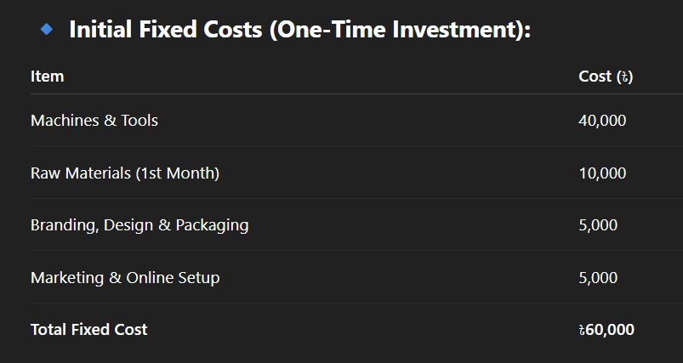
Home
Services
Features
About Us
Break Even Point – When Profit Begins
Break-Even Point Calculation:
Break-Even(Months)=৳60,000/৳32,600 ................................≈1.84

Slide 9
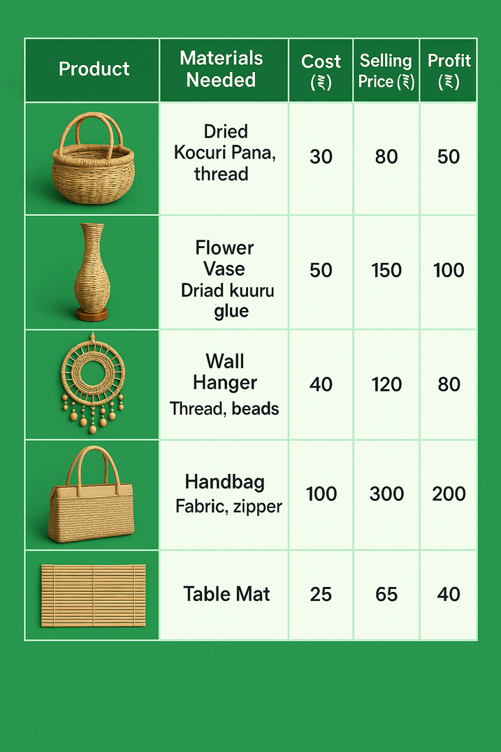
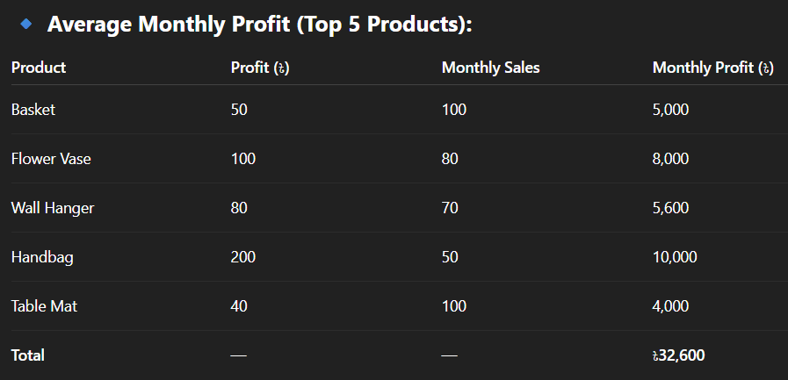
Home
Services
Features
About Us
Average Monthly Profit (Top 5 Products):
We reach break-even in just 2 months, and earn pure profit from month 3 onward!

Slide 10
Home
Services
Features
About Us
Essential Machines & Estimated Costs
Save time by speeding up cutting, drying, sewing, and mixing
Ensure consistent quality for global markets like Fiverr
Increase production capacity for larger orders
Lower labor costs and increase profit margins
Create uniform products that build customer trust

Slide 11
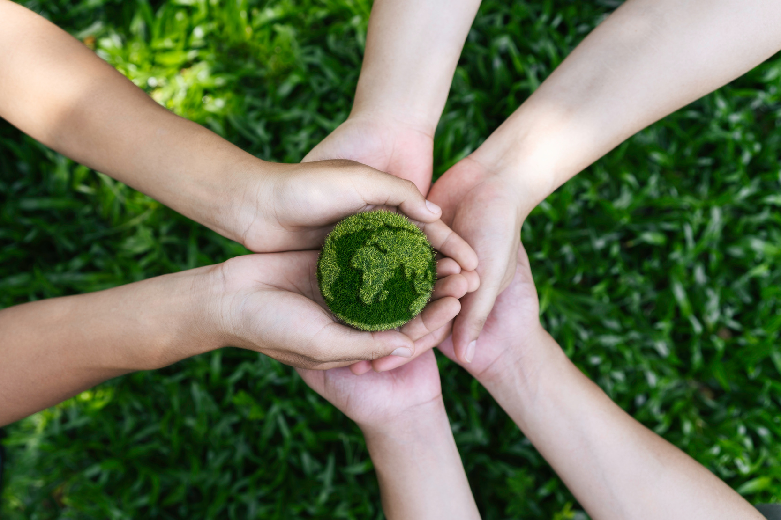
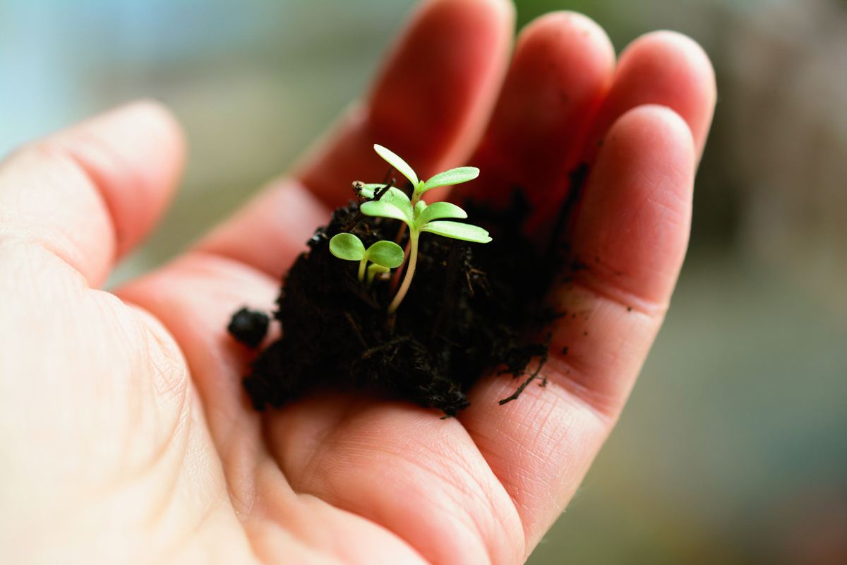
Home
Services
Features
About Us
Why
This Business Will Work
Abundant raw material (Kocuri grows naturally)
Low-cost startup with digital platforms (Fiverr, Facebook, Etsy)
No major competitors in this niche
Addresses plastic pollution and unemployment
Growing global demand for eco-friendly products

Slide 12
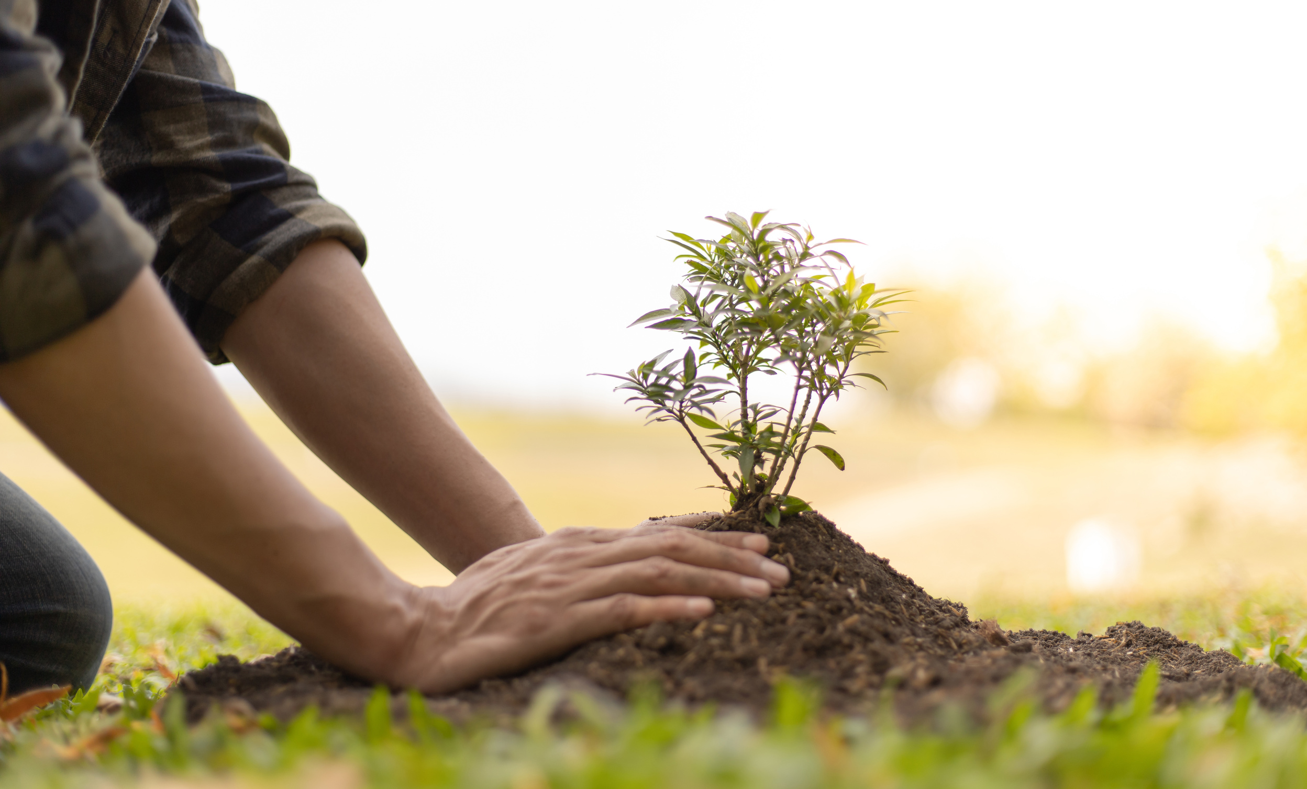
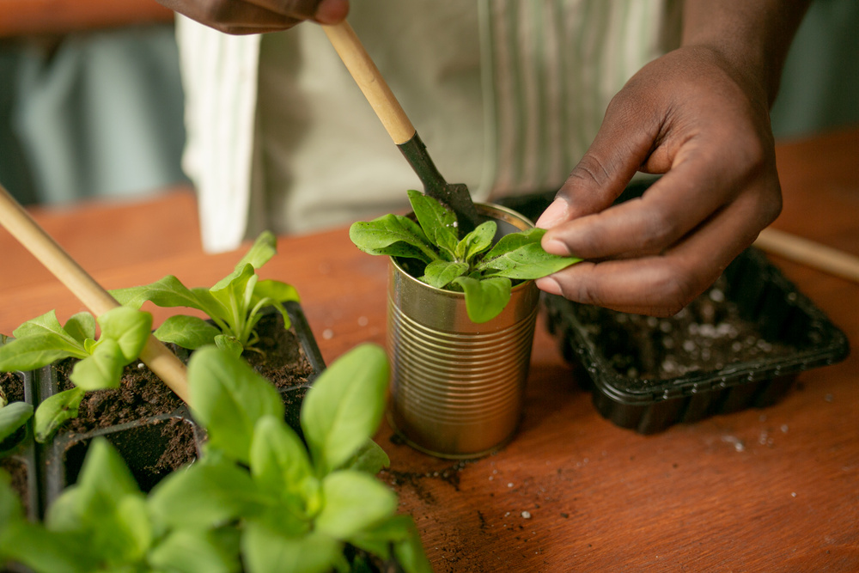
Salford & Co.
Home
Services
Features
About Us
Why
It’s Important for Bangladesh
Eco Solution:
Controls invasive water weed clogging waterways
Job Creation:
Empowers rural women and youth
Plant trees and support green initiatives.
Eco Branding:
Positions Bangladesh as a green innovator
Digital Export Boost:
Links rural artisans to global markets

Slide 13

Salford & Co.
Home
Services
Features
About Us
Our Future Vision
Sell globally via Etsy, Amazon Handmade
Create 500+ rural jobs
Launch full eco-fragrance product line (bathroom, room, clothes)
Make Kocuri Pana Bangladesh’s symbol of green innovation
thinktrak25@gmail.com
www.thinktrak.com
+880 1.225-567788
123 Anywhere St., Any City, ST 12345

Slide 14
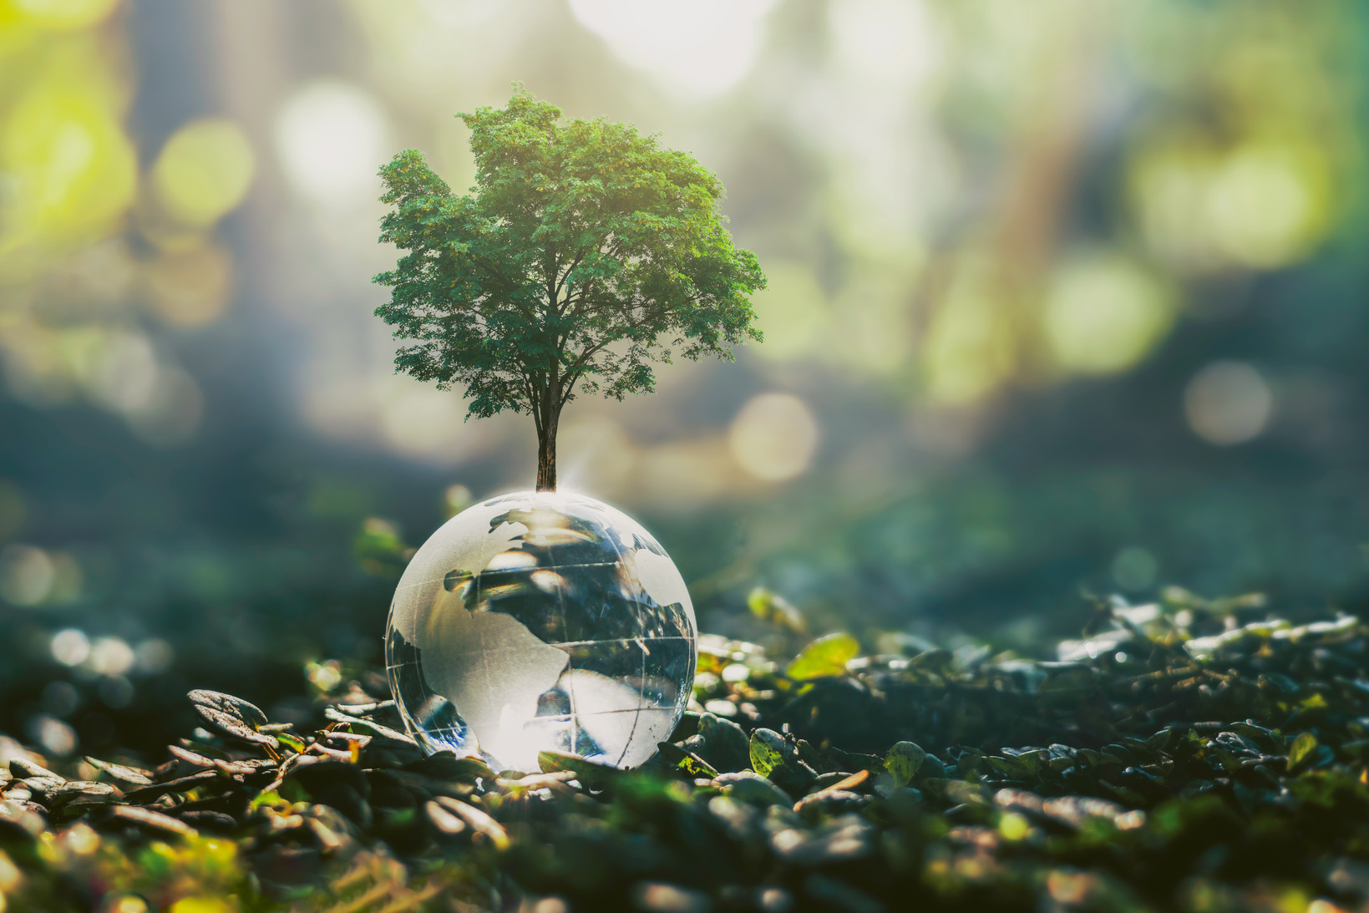
Salford & Co.
Home
Services
Features
About Us
Conclusion
& Call to Action
Let’s Build Bangladesh, Naturally
Support local innovation.
Choose eco-friendly products over plastic.
Make Kocuri Pana the face of Bangladesh’s green future!

